Slide 1
Predicting Fracture Patterns in 2D Materials using Deep Learning
Journal Club Talk
Vinit Doke
July 22, 2022

Slide 2
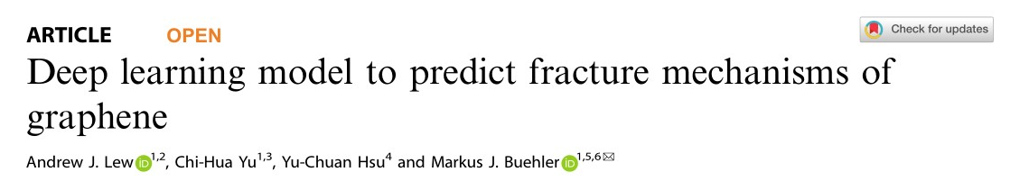
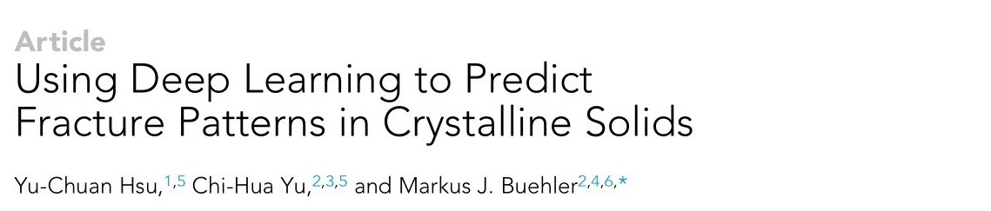
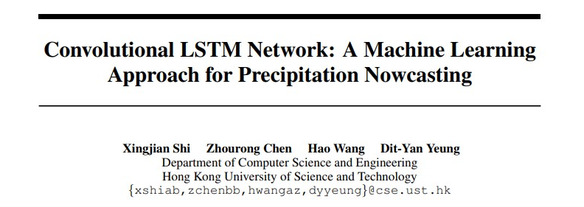
Articles
April, 2021
July, 2020
2015

Slide 3
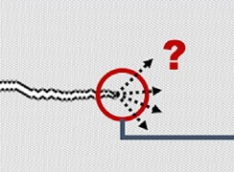

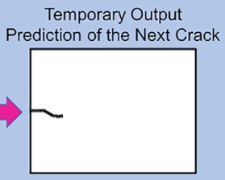
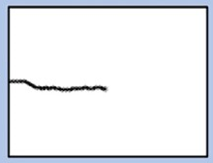
Motive

Slide 4
Previous Approaches
Convolutional Neural Network based approach
Initial Input
1st Output
CNN Model
+
Input Vector for Next Step

Slide 5

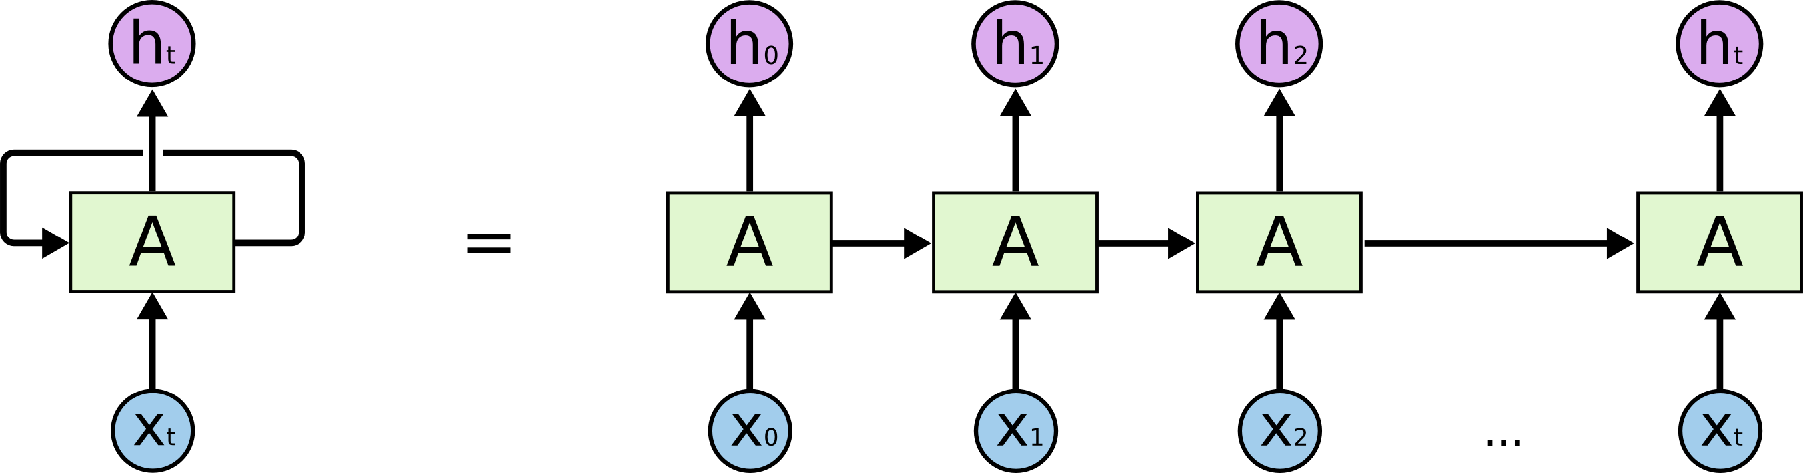
Convolutional LSTMs
Convolutional Layer : Extracts Visual Features
Long Short-term Memory Networks or LSTM : Learning the connectivity of Elements in sequence

Slide 6
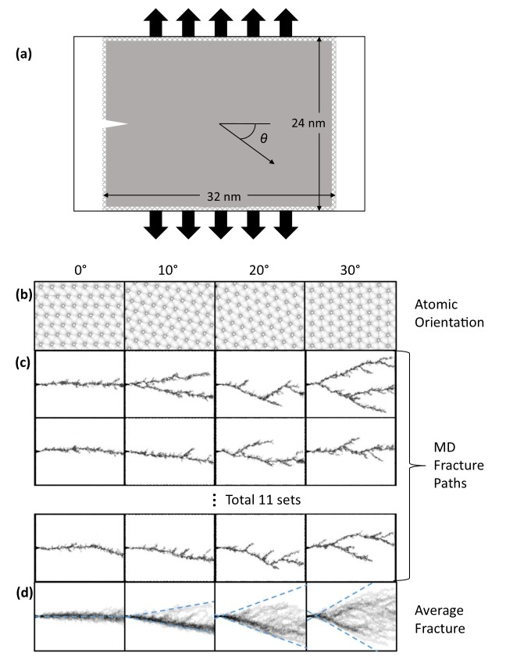
Generation of Training Data
Simulated Cell (24 nm x 32nm) mapped to a resolution
Of 120 x 160 pixels
Pixels in Averaged Fracture paths which are darker indicate the Faultline
went through there more often

Slide 7
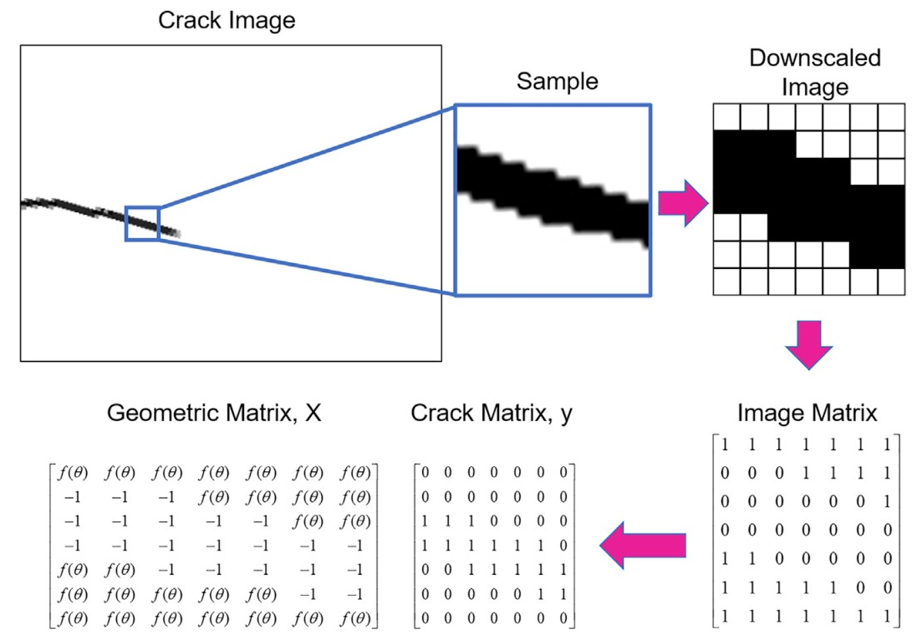
Representation of Cracks
atoms with fewer neighbors i.e.,
those along the fracture path,
are colored darker using a binary color map

Slide 8
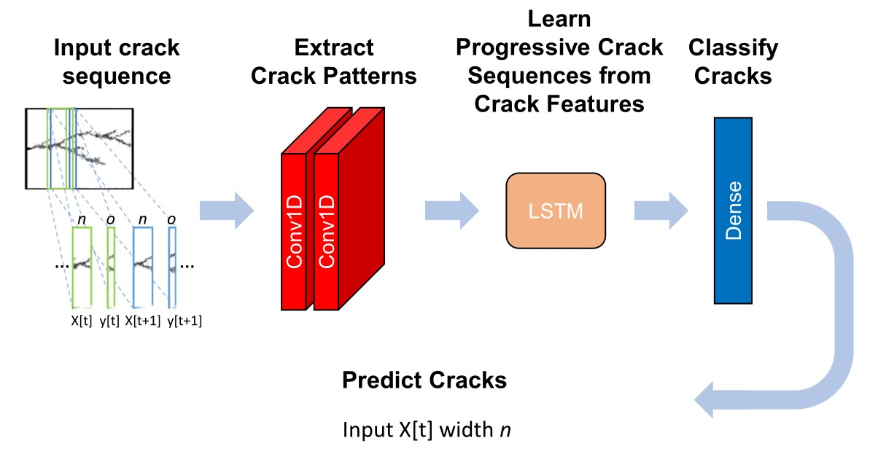
Model Architecture

Slide 9
Training & Parameter Tuning
‘Predicted fracture paths tend to become more complex and in
closer alignment to MD results as the input width increases to 32’ {5 nm}
Not accounting for enough fracture history leads to spurious predictions of straight horizontal line paths with little branching

Slide 10
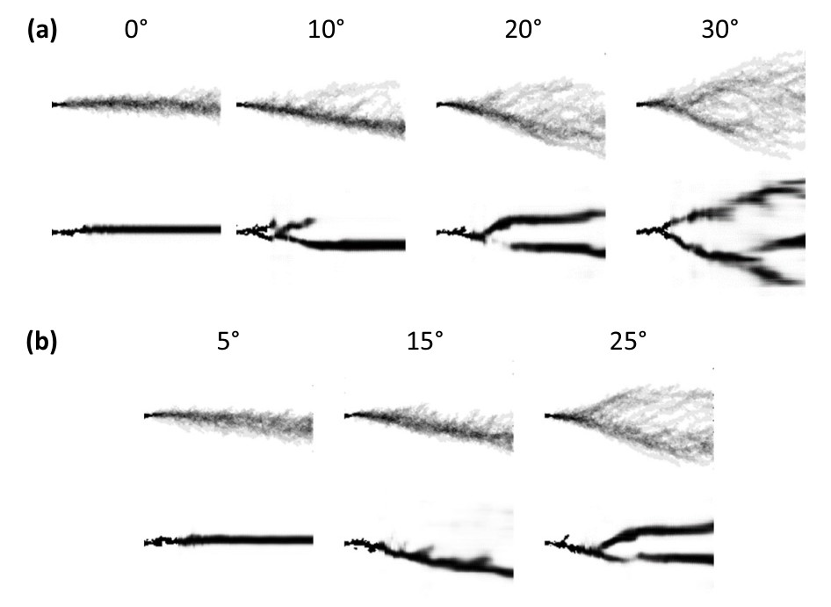
Results
MD Simulations
Model Inference on Training Data
MD Simulations
Model Inference on Undisclosed Orientation Angles

Slide 11
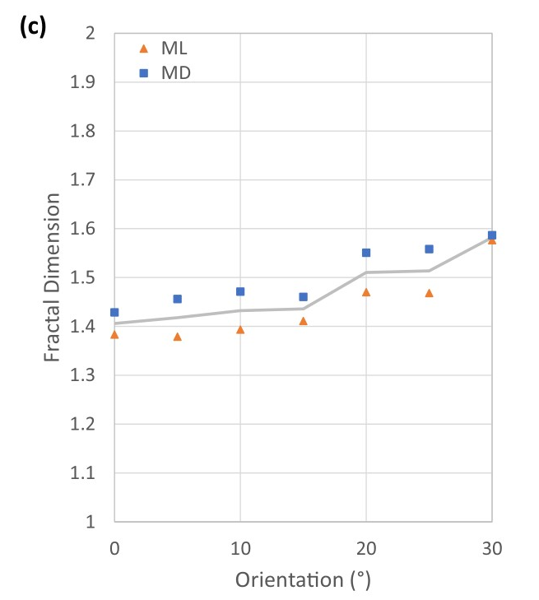
Comparison

Slide 12
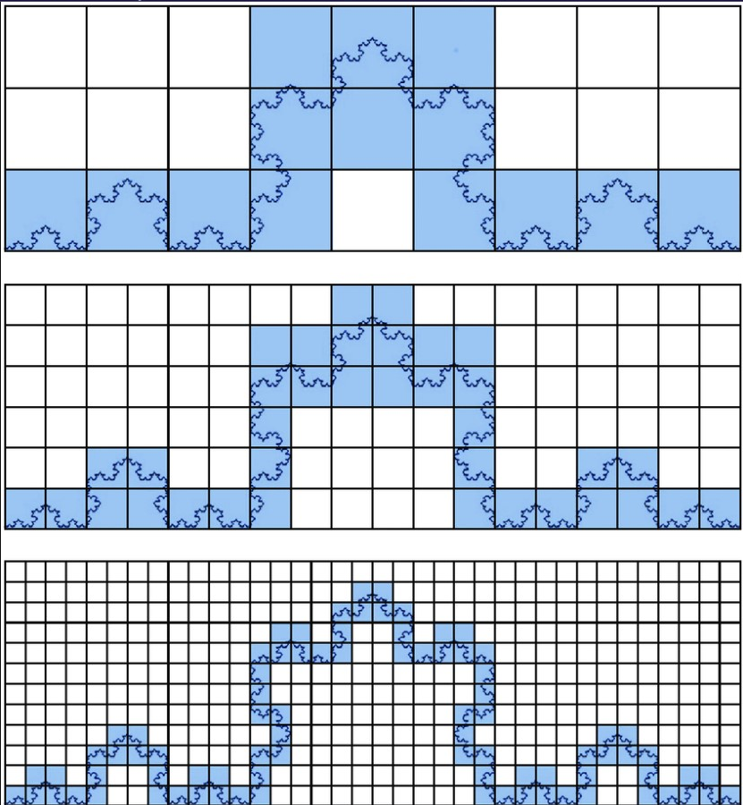

Evaluation Metric
Fractal Dimension using Box Counting Method
N : number of boxes that cover the pattern
R : magnification, or the inverse of the box size
$$D= \frac{log⁡(N)}{log⁡(R)}$$

Slide 13
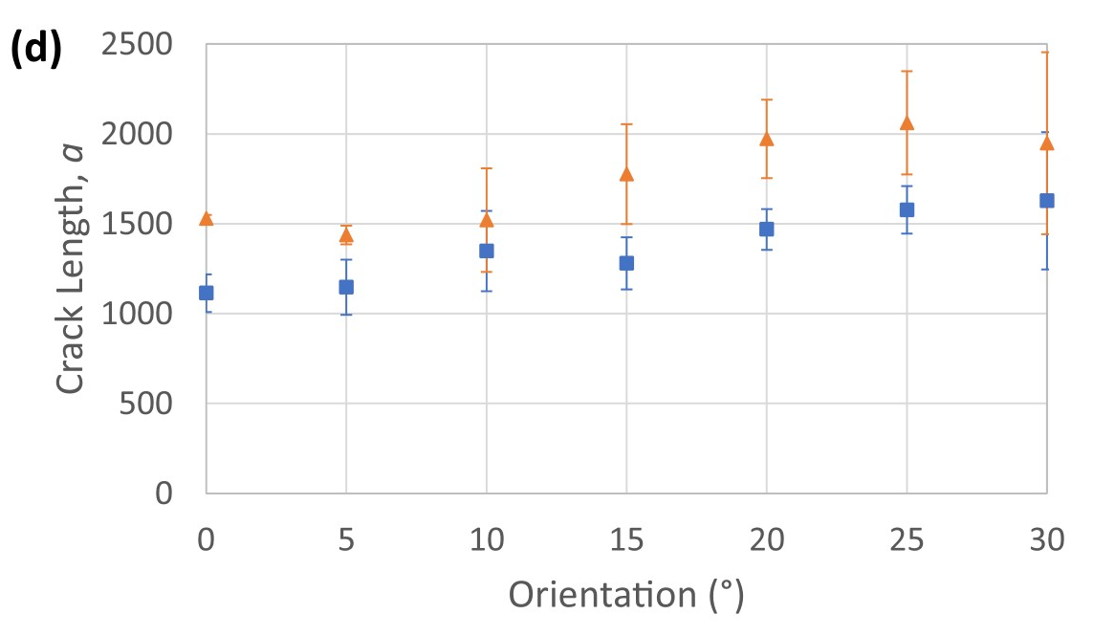
Results

Slide 14
Further Exploration
Modelling Point Defects
Interfaces

Slide 15
Appendix
Architecture
ConvNET
2 1-D Conv Layers
64 Filters
Kernel Sizes : 60 and 61
LSTM NET
512 LSTM Units
Dense NET
120 Neurons

